Slide 1
Enhancing Practices and Strengthening Core Competencies in Disaster Nursing through the Learning HUB
(ECoDN-HUB)
TIMISOARA/ROMANIA
Cooperation partnerships in higher education (KA220-HED)

Slide 2
Training on Virtual Reality and Scriptwriting
How to Create Effective VR Simulations

Slide 3
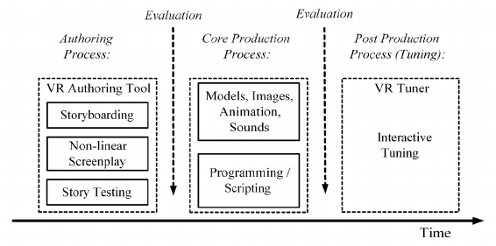

Slide 4
Structure of a VR Script
Initial briefing and instructions
Interactive decision-making moments
Realistic visual and audio elements
User performance evaluation

Slide 5
Practical Script Development
Selecting the simulation topic
Designing a storyboard and visual presentation
Identifying key decision points
Testing and iterating the script

Slide 6
VR Technologies and Tools
Hardware and software
Importing 3D models and animations

Slide 7
Scenario objectives
What skills and knowledge should the participant take away?
HARD Skills
Use of tourniquet, bandage
SOFT Skill Resistance to stress Assessing the situation and making decisions – recognizing critical bleeding and choosing the right course of action Teamwork in simulation – if VR is multiplayer, cooperation with other participants is necessary

Slide 8
Description of the situation
In front of the user lies a young man who is bleeding profusely from a deep wound on his forearm. His clothes are stained with blood and his breathing is fast and irregular. He looks up at the user with a frightened expression and says in a quiet voice: "Help me..." Next to him on the ground lies broken glass, probably the cause of his injuries. The user must make a quick decision – assess the condition of the injured person, stop the bleeding and ensure that the patient is safe before the ambulance arrives. In an interactive environment, they can choose various tools from the first aid kit, communicate with the patient and instruct surrounding witnesses to call for help. As soon as he begins to administer first aid, the scenario reacts dynamically – if he presses the bandage correctly on the wound, the bleeding slows down, but if he hesitates or uses the wrong technique, the patient begins to show signs of shock, which complicates the situation. The aim of this scenario is to simulate realistic first aid training under pressure, where the player learns to react correctly in a crisis situation.

Slide 9
Description of the enviroment
The user finds himself on the street next to an injured person lying on the ground. The surrounding environment is busy – you can hear muffled voices of people, the distant sound of sirens and the hustle and bustle of the city. The surrounding houses are damaged by the earthquake Curious passers-by are slowly gathering around.

Slide 10
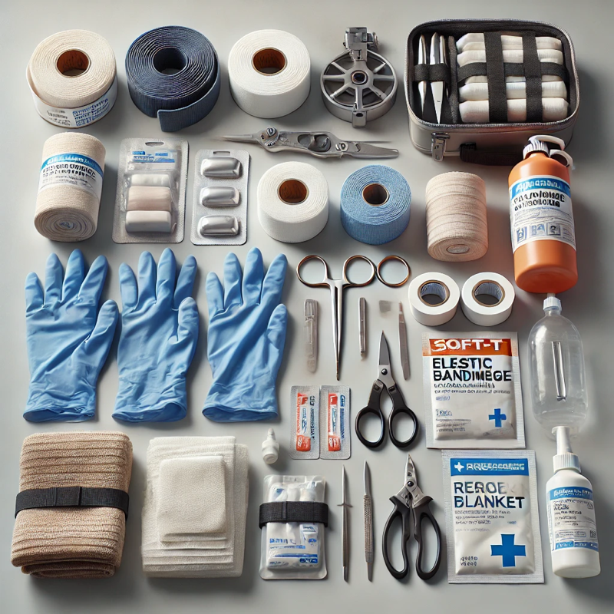
Tools and objects
Write what tools are needed – according to the textbook, standard, add pictures

Slide 11
Interaction – what should the participant do?
The user must make a quick decision – assess the condition of the injured person (physiological functions, general condition), stop the bleeding and ensure that the patient is safe before the ambulance arrives. In an interactive environment, they can choose various tools from the first aid kit, communicate with the patient and instruct surrounding witnesses to call for help. As soon as he starts to perform first aid, the scenario reacts dynamically – if he applies the bandage correctly to the wound, the bleeding slows down, but if he hesitates or uses the wrong technique, the patient begins to show signs of shock, which complicates the situation.

